Slide 1
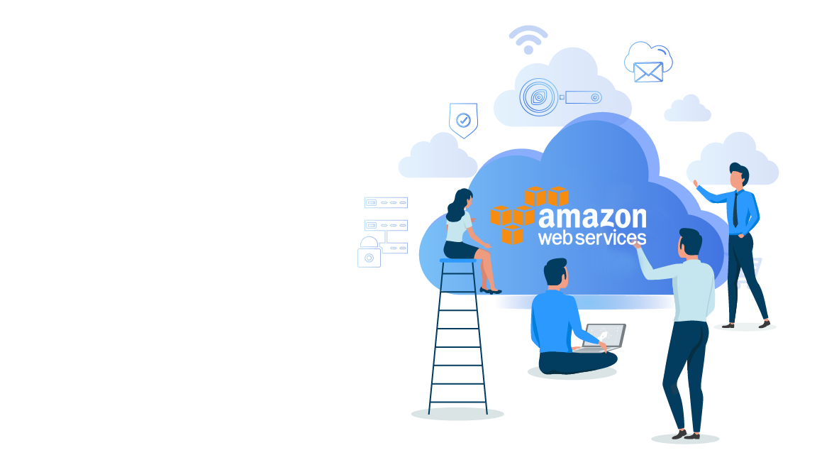


AWS Well-Architected Framework & Architecting for the Cloud

Slide 2
Agenda
01
Traditional Vs. Cloud Computing Environments
02
General Design Principles
04
Five Pillars of a Well Architected Framework
05
Best Practice Areas &
Key AWS Services

Slide 3
Traditional Vs. Cloud Computing Environments

Slide 4





Difference Between Traditional & Cloud
Whether you are re-architecting the applications that currently run in your on-premise environment to run on AWS, or migrating directly to AWS, or designing cloud-native applications, you must consider the differences between traditional environments and cloud computing environments.
Global, Available, and Scalable Capacity
Built-in Security
Operations on AWS
IT Assets as Provisioned Resources
Higher-Level Managed Services
Architecting for Cost

Slide 5

Traditional Vs. Cloud Computing
IT Assets as Provisioned Resources
In a traditional computing environment, you provision capacity based on an estimate of a theoretical maximum peak. With cloud computing, you can access as much or as little capacity as you need and dynamically scale to meet actual demand, while only paying for what you use.
Global, Available, and Scalable Capacity
Higher-Level Managed Services
Built-in Security
Architecting for Cost
Operations on AWS

Slide 6
Traditional Vs. Cloud Computing
IT Assets as Provisioned Resources
Using the global infrastructure of AWS, you can deploy your application to the AWS Region that best meets your requirements. For global applications, you can reduce latency to end users around the world by using the Amazon CloudFront content delivery network (CDN)
Global, Available, and Scalable Capacity
Higher-Level Managed Services
Built-in Security
Architecting for Cost
Operations on AWS

Slide 7
Traditional Vs. Cloud Computing
IT Assets as Provisioned Resources
Apart from the compute resources of Amazon Elastic Compute Cloud (Amazon EC2), you also have access to a broad set of storage, database, analytics, application, and deployment services. These services are instantly made available within a few clicks.
Global, Available, and Scalable Capacity
Higher-Level Managed Services
Built-in Security
Architecting for Cost
Operations on AWS

Slide 8
Traditional Vs. Cloud Computing
IT Assets as Provisioned Resources
Cloud provides governance capabilities that enable continuous monitoring of configuration changes to your IT resources. Security
at AWS is the highest priority, which means that you benefit from data centers and network architecture that are built to meet the requirements of the most security sensitive organizations.
Global, Available, and Scalable Capacity
Higher-Level Managed Services
Built-in Security
Architecting for Cost
Operations on AWS

Slide 9
Traditional Vs. Cloud Computing
IT Assets as Provisioned Resources
Traditional cost management of on-premise solutions is not typically tightly coupled to the provision of services. When you provision a cloud computing environment, optimizing for cost is a fundamental design tenant for architects. AWS provides fine-grained billing, which enables you to track the costs associated with all aspects of your solutions
Global, Available, and Scalable Capacity
Higher-Level Managed Services
Built-in Security
Architecting for Cost
Operations on AWS

Slide 10
Traditional Vs. Cloud Computing
IT Assets as Provisioned Resources
AWS provides tooling, processes, and best practices to support the transition of operational practices to maximize the benefits that can be leveraged from cloud computing.
Global, Available, and Scalable Capacity
Higher-Level Managed Services
Built-in Security
Architecting for Cost
Operations on AWS

Slide 11
General Design Principles

Slide 12





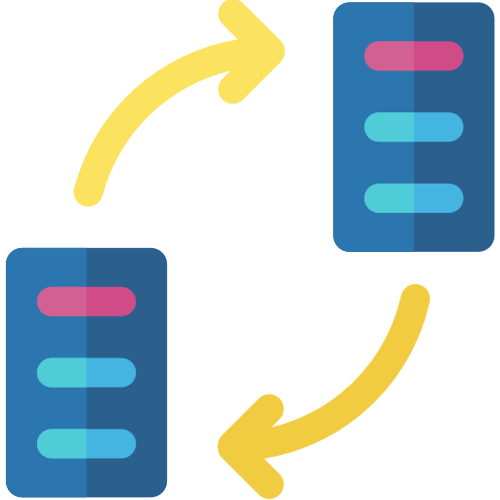

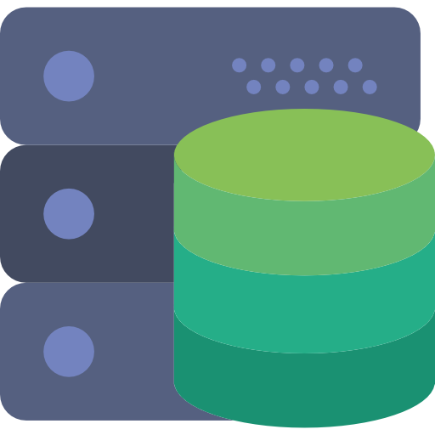

General Design Principles
Scalability
Services, Not Servers
Loose Coupling
Automation
01
02
03
04
Database &
Data Volumes
Cost Optimization
Caching
Security
05
06
07
08

Slide 13
General Design Principles
Scalability
Services, Not Servers
Loose Coupling
Automation
01
02
03
04
Applications that are expected to grow over time need to be built on top of a scalable
architecture. Such an architecture supports growth in users, traffic, or data size
with no drop-in performance.

Slide 14
General Design Principles
Scalability
Services, Not Servers
Loose Coupling
Automation
01
02
03
04
Traditional IT infrastructure requires you to manually react to a variety of events. With cloud computing environment, there is an opportunity for automation such as server less management and Deployment, Auto scaling and more.

Slide 15
General Design Principles
Scalability
Services, Not Servers
Loose Coupling
Automation
01
02
03
04
With traditional IT infrastructure, organizations have to build and operate all the IT components on their own. While, with Cloud Computing, most of these required components are offered as services accessed via the internet.
Notes:
There's always a large requirement of variety of technology components when it come to developing, managing and operating applications, especially at scale.

Slide 16
General Design Principles
Scalability
Services, Not Servers
Loose Coupling
Automation
01
02
03
04
Cloud computing encourages multi architecture systems for applications which let's organizations design and keep the application complexity in check by creating smaller, loosely coupled components. It also reduces the interdepencies.

Slide 17
General Design Principles
Database &
Data Volumes
Cost Optimization
Caching
Security
05
06
07
08
Cloud computing provides various managed database engines offering enterprise performance at open source cost. Data lake architecture is another plus point with cloud, which organizations can use to store massive amounts of data in a central location so that it's readily available to be categorized, processed, analyzed, and consumed by diverse groups within the organization.

Slide 18
General Design Principles
Database &
Data Volumes
Cost Optimization
Caching
Security
05
06
07
08
Cloud reduces capital expenses and drive savings as a result. AWS even provides various ways for organization to track and identify the cost saving opportunities.

Slide 19
General Design Principles
Database &
Data Volumes
Cost Optimization
Caching
Security
05
06
07
08
Cloud environment offers caching services to store any previously calculated data for future use. This helps in improving application performance.

Slide 20
General Design Principles
Database &
Data Volumes
Cost Optimization
Caching
Security
05
06
07
08
Most of the security methods and tools available for traditional IT infrastructure can also be used in the cloud. AWS also offers it's own various security solutions for applications on AWS. It also let's you formalize the design of security controls.

Slide 21
The Five Pillars of A Well Architected Framework

Slide 22
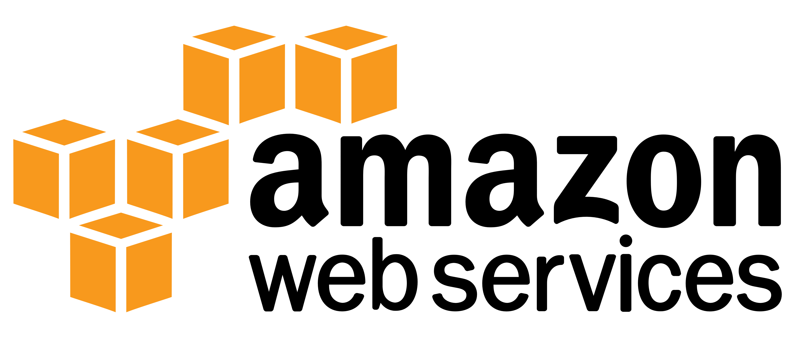

Five Pillars of a Well Architected Framework
Incorporating the five pillars into the architecture, helps produce stable and efficient systems that will deliver on your expectations and requirements.
Operational Excellence
Security
Reliability
Performance Efficiency
Cost Optimization

Slide 23



Operational Excellence
How do we build the foundation of Operational Excellence pillar in our framework?
Operational Excellence pillar refers to the ability to run and monitor systems, and to gain insight into the system's operations in order to deliver business value.
01

Slide 24


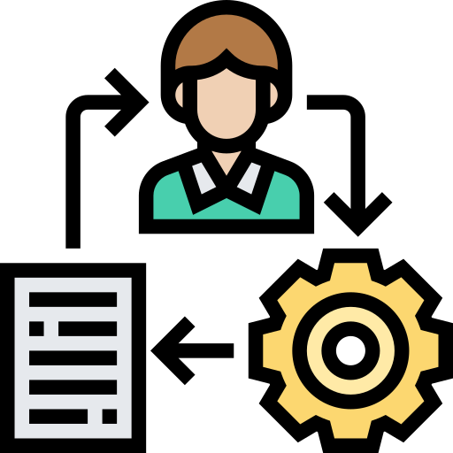

Operational Excellence
Design Principles
Anticipate Failure
Perform operations as code
Annotate Documentation
Make frequent, small, reversible changes
In the cloud, you can automate the creation of annotated documentation after every build (or automatically annotate hand-crafted documentation). Annotated documentation can be used by people and systems.
Identify potential sources of failure so that they can be removed or mitigated. Test your failure scenarios and Test your response procedures to ensure they are effective.
You can define your entire workload (applications, infrastructure) as code and update it with code. You can implement your operations procedures as code and automate their execution by triggering them in response to events.
Design workloads to allow components to be updated regularly to increase the flow of
beneficial changes into your workload. Make changes in small increments that can be reversed if they fail.
04
03
02
01

Slide 25
Operational Excellence
Best Practice Areas & key AWS Services
Prepare
Operate
Evolve
Create mechanisms to validate that workloads, or changes, are ready to be moved into production and supported by operations. Operational readiness is validated through checklists to ensure a workload meets defined standards.
Define expected outcomes, determine how success will be measured, and identify the workload and operations metrics that will be used in those calculations to determine if operations are successful.
Dedicate work cycles to making continuous incremental improvements. Regularly evaluate and prioritize opportunities for improvement.
01
02
03
Key AWS Service: AWS Config
Key AWS Service: Amazon CloudWatch
Key AWS Service: Amazon Elasticsearch Services

Slide 26


Security
How do we build the foundation of Security pillar in our framework?
The security Pillar refers to the ability to protect information, systems, and assets while delivering business value through risk assessments and mitigation strategies.
02

Slide 27
Security
Design Principles
Protect data in transit and at rest
Apply security at all layers
Implement a Strong Identity Foundation
Enable traceability
Classify your data into sensitivity levels and use mechanisms, such as encryption, tokenization, and access control where appropriate.
Rather than just focusing on protection of a single outer layer, apply a defense-in-depth approach with other security controls.
Monitor and alert the audit actions and changes to your
environment in real time. Integrate logs and metrics with systems to automatically
respond and take action.
Implement the principle of least privilege and enforce separation of duties with appropriate authorization for each interaction with your AWS resources. Centralize privilege management and reduce or even eliminate reliance on long-term credentials.
04
03
02
01

Slide 28
Security
Best Practice Areas & key AWS Services
Identity and Access Management
Detective Controls
Infrastructure Protection
Ensuring that only authorized and authenticated users are able to access your resources, and only in a manner that you intend could protect your data and applications from various security threats.
You can use detective controls to identify a potential security threat or incident. You can also use internal auditing, to ensure that practices meet policies and requirements and that you have set the correct automated alerting notifications based on defined conditions.
Infrastructure protection encompasses control methodologies, such as defense in depth in levels of your framework.
01
02
03
Key AWS Service: AWS IAM
Key AWS Service: AWS CloudTrail
Key AWS Service:
Amazon Virtual Private Cloud, Amazon CloudFront

Slide 29
Security
Best Practice Areas & key AWS Services
Data Protection
Incident Response
04
05
Implement data classification, that provides a way to categorize organizational data based on levels of sensitivity. Implement encryption which protects data by making it unintelligible to unauthorized access.
Even with extremely mature preventive measures and detective controls, your organization should still put processes in place to respond to security incidents and mitigate the potential impact of security incidents.
Key AWS Service:
ELB, Amazon EBS, Amazon S3, Amazon RDS, and AWS KMS
Key AWS Service: AWS CloudFormation

Slide 30

Reliability
How do we build the foundation of Reliability pillar in our framework?
Reliability pillar represents the ability of a system to recover from infrastructure or service disruptions, dynamically acquire computing resources to meet demand, and mitigate disruptions such as misconfigurations or transient network issues.
03

Slide 31
Reliability
Design Principles
Test recovery procedures
Automatically recover from failure
Scale horizontally to increase aggregate system availability
Stop guessing capacity
In the cloud, you can test how your system fails, and you can validate your recovery procedures. This exposes failure pathways that you can test and rectify before a real failure scenario
By monitoring a system for key performance indicators (KPIs), you can trigger automation when a threshold is breached. This allows for automatic notification and tracking of failures
Replace one large resource with multiple small resources to reduce the impact of a single failure on
the overall system. Distribute requests across multiple, smaller resources to ensure that they don't share a common point of failure.
A common cause of failure in on-premises systems is resource saturation, when the demands placed on a system exceed the capacity of that system
04
03
02
01

Slide 32
Reliability
Best Practice Areas & key AWS Services
Foundations
Change Management
Failure Management
Before architecting any system, foundational requirements that influence reliability should be in place. For example, you must have sufficient network bandwidth to your data center.
Being aware of how change affects a system allows you to plan proactively, and monitoring allows you to quickly identify trends that could lead to capacity issues or SLA breaches.
In any system of reasonable complexity it is expected that failures will occur. It is generally of interest to know how to become aware of these failures, respond to them, and prevent them from happening again.
01
02
03
Key AWS Service: AWS IAM
Key AWS Service: AWS CloudTrail
Key AWS Service: AWS CloudFormation

Slide 33

Performance Efficiency
How do we build the foundation of Performance Efficiency pillar in our framework?
Performance efficiency pillar represents the ability to use computing resources efficiently to meet system requirements and to maintain that efficiency as the demand changes.
04

Slide 34
Performance Efficiency
Design Principles
Use serverless architectures
Go global in minutes
Democratize advanced technologies
Serverless architectures remove the need for you to run and maintain servers to carry out traditional compute activities. This not only removes the operational burden of managing these servers, but also can lower transactional costs.
Easily deploy your system in multiple Regions around the world with just a few clicks. This allows you to provide lower latency and a better experience for your customers at minimal cost.
In an organization, rather than having their IT team learn how to host and run a new technology, they can simply consume it as a service.
03
02
01

Slide 35
Performance Efficiency
Best Practice Areas & key AWS Services
Selection
Review
Monitoring
The optimal solution for a particular system will vary based on the kind of workload you have, often with multiple approaches combined. Well-architected systems use multiple solutions and enable different features to improve performance.
When architecting solutions, there is a finite set of options that you can choose from. However, over time new technologies and approaches become available that could improve the performance of your architecture.
After you have implemented your architecture you will need to monitor its performance so that you can remediate any issues before your customers are aware. Monitoring metrics should be used to raise alarms when thresholds are breached.
01
02
03
Key AWS Service: Services in compute, storage and more
The AWS Blog and the What's New section on the AWS website
Key AWS Service: Amazon CloudWatch

Slide 36

Cost Optimization
How do we build the foundation of Cost Optimization pillar in our framework?
Cost optimization pillar refers to the ability to run systems to deliver business value at the lowest price point.
05

Slide 37
Cost Optimization
Design Principles
Adopt a consumption model
Analyze and attribute expenditure
Measure overall efficiency
Stop spending money on data center operations
Pay only for the computing resources that you require and increase or decrease usage depending on business requirements, not by using elaborate forecasting.
The cloud makes it easier to accurately identify the usage and cost of systems, which then allows transparent attribution of IT costs to individual workload owners
Measure the business output of the workload and the costs associated with delivering it. Use this measure to know the gains you make from increasing output and reducing costs.
AWS does the heavy lifting of racking, stacking, and powering servers, so you can focus on your customers and organization projects rather than on IT infrastructure.
04
03
02
01

Slide 38
Cost Optimization
Best Practice Areas & key AWS Services
Expenditure Awareness
Cost-Effective Resources
Matching supply and demand
The capability to attribute resource costs to the individual organization or product owners drives efficient usage behavior and helps reduce waste
Using the appropriate instances and resources for your workload is key to cost savings. A well-architected workload uses the most cost-effective resources, which can have a significant and positive economic impact.
Optimally matching supply to demand delivers the lowest cost for a workload, but there also needs to be sufficient extra supply to allow for provisioning time and individual resource failures
01
02
03
Key AWS Service: AWS Cost Explorer
AWS Key Services: AWS Direct Connect, Amazon CloudFront, Amazon RDS and more
Key AWS Service: AWS Auto Scaling

Slide 39
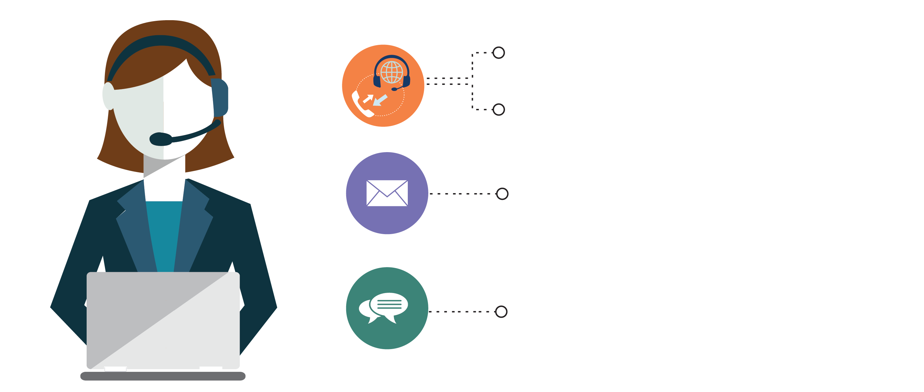
India: +91-7847955955
US: 1-800-216-8930 (TOLL FREE)
support@intellipaat.com
24/7 Chat with Our Course Advisor
Notes:
Thank you!

